Slide 1

UNDERSTANDING AIRLINE PASSENGER SATISFACTION THROUGH DATA-DRIVEN ANALYSIS
INFOST 582G FINAL PROJECT
SAMANTH MADHESH
MAY 11, 2025

Slide 2

No data is clean, but most is useful.
-George Box

Slide 3
EXECUTIVE SUMMARY
In this project, I explored the key factors that influence airline passenger satisfaction using a publicly available dataset. The objective was to identify patterns in passenger feedback, apply predictive models to classify satisfaction levels, and ultimately provide actionable recommendations for airlines.
I started by cleaning and preparing the data, followed by a thorough exploratory data analysis (EDA) to uncover trends and relationships among variables such as service quality, delays, travel class, and customer demographics. Key service features like online boarding, inflight entertainment, and seat comfort showed strong positive correlations with satisfaction, while delays and economy class travel tended to align with dissatisfaction.
To quantify the predictive power of these features, I built two classification models: Logistic Regression and Random Forest. Logistic Regression offered a solid baseline with an accuracy of 86.7%, while Random Forest outperformed it with an impressive 96.2% accuracy, demonstrating its strength in handling nonlinear patterns.
Finally, the insights from these analyses were translated into strategic recommendations. I suggested ways airlines could improve satisfaction—such as enhancing economy-class service, reducing delays, investing in digital experiences, and reinforcing loyalty programs.
This project combines technical analysis with practical relevance, showing how data science can play a valuable role in improving customer experience in the airline industry.

Slide 4

INTRODUCTION
In today’s highly competitive airline industry, passenger satisfaction plays a pivotal role in building brand loyalty, increasing retention, and ensuring positive customer experiences. Airlines collect a wealth of data on passenger demographics, travel patterns, and service feedback, yet the challenge lies in translating this data into actionable insights. With the rise of digital platforms and inflight technology, passengers are more vocal and selective than ever.
This project leverages data science techniques to explore and predict airline passenger satisfaction. By analyzing structured service review data, we aim to identify which factors contribute most to a positive travel experience and how airlines can use this knowledge to make data-informed service improvements.

Slide 5
BACKGROUND AND RESEARCH QUESTIONS
The dataset used in this project was collected from a public source and contains survey responses from passengers rating their experience with various service aspects such as check-in process, inflight services, delays, and digital features like Wi-Fi and online booking.
This project is guided by the following research questions:
What are the most important features influencing airline passenger satisfaction?
How do demographic factors (e.g., age, gender, loyalty) relate to satisfaction levels?
Can we use a passenger’s service ratings and flight details to predict their satisfaction?
Are there distinguishable clusters or segments of passengers based on satisfaction-related behaviors?

Slide 6
DATA COLLECTION
The dataset used in this analysis is publicly available on Kaggle. It contains records of airline passengers, including demographic details, flight characteristics, service ratings, and satisfaction labels. The dataset was not collected manually, but instead downloaded as a CSV file consisting of two parts: test.csv and train.csv
For this project, the train.csv file was used for the full analysis.
Source: Kaggle Airline Passenger Satisfaction Dataset
URL: https://www.kaggle.com/datasets/teejmahal20/airline-passenger-satisfaction
Size: ~100,000 records (combined)

Slide 7
DATA STRUCTURES
The data was originally structured as a flat file (CSV) and contained 25 columns:
Demographic Features: Gender, Age, Customer Type
Flight Attributes: Flight Distance, Class, Type of Travel
Service Ratings: Numeric scores (0–5) for services like Food and drink, Online boarding, Inflight wifi service, etc.
Logistics: Departure Delay in Minutes, Arrival Delay in Minutes
Target Variable: Satisfaction (binary: satisfied or neutral or dissatisfied)
Redundant fields like id and Unnamed: 0 were dropped.
Encoding & Transformation: Categorical variables (Gender, Class, Customer Type, etc.) were label-encoded to convert them into numerical format suitable for modeling. The final dataset contains only numeric columns, allowing compatibility with most machine learning models.

Slide 8
DATA CLEANING
Several preprocessing steps were performed:
Dropped unnecessary columns: id, Unnamed: 0
Checked for missing values: Found ~310 missing values in Arrival Delay in Minutes (train), filled with the median
Label Encoding: Transformed categorical text variables into numeric codes using LabelEncoder
Validated data types: Ensured all features are in numerical format for downstream analysis

Slide 9
SUMMARY STATISTICS
Gender | Customer Type | Age | Type of Travel | Class | Flight Distance | Inflight wifi service | Departure/Arrival time convenient | Ease of Online booking | Gate location | Inflight entertainment | On-board service | Leg room service | Baggage handling | Checkin service | Inflight service | Cleanliness | Departure Delay in Minutes | Arrival Delay in Minutes | satisfaction
count | 103904 | 103904 | 103904 | 103904 | 103904 | 103904 | 103904 | 103904 | 103904 | 103904 | 103904 | 103904 | 103904 | 103904 | 103904 | 103904 | 103904 | 103904 | 103904
mean | 0.492541 | 0.182678 | 39.379706 | 0.310373 | 0.594135 | 1189.44838 | 2.729683 | 3.060296 | 2.756901 | 2.976883 | 3.358158 | 3.382363 | 3.351055 | 3.631833 | 3.640428 | 3.286351 | 14.815618 | 15.133392 | 0.433333
std | 0.499947 | 0.386404 | 15.114964 | 0.462649 | 0.620799 | 997.147281 | 1.327829 | 1.525075 | 1.398929 | 1.277621 | 1.332991 | 1.288354 | 1.315605 | 1.180903 | 1.175663 | 1.312273 | 38.230901 | 38.649776 | 0.495538
min | 0 | 0 | 7 | 0 | 0 | 31 | 0 | 0 | 0 | 0 | 0 | 0 | 0 | 1 | 0 | 0 | 0 | 0 | 0
25% | 0 | 0 | 27 | 0 | 0 | 414 | 2 | 2 | 2 | 2 | 2 | 2 | 2 | 3 | 3 | 3 | 2 | 0 | 0
50% | 0 | 0 | 40 | 0 | 1 | 843 | 3 | 3 | 3 | 3 | 4 | 4 | 4 | 4 | 3 | 4 | 3 | 0 | 0
75% | 1 | 0 | 51 | 1 | 1 | 1743 | 4 | 4 | 4 | 4 | 4 | 4 | 4 | 5 | 4 | 5 | 4 | 12 | 13
max | 1 | 1 | 85 | 1 | 2 | 4983 | 5 | 5 | 5 | 5 | 5 | 5 | 5 | 5 | 5 | 5 | 5 | 1592 | 1584

Slide 10
EXPLORATORY DATA ANALYSIS (EDA)
To better understand the structure and behavior of the dataset, I conducted a series of visual and statistical analyses. These insights laid the foundation for feature selection and model development. Each plot uncovers hidden patterns that could directly influence passenger satisfaction.

Slide 11

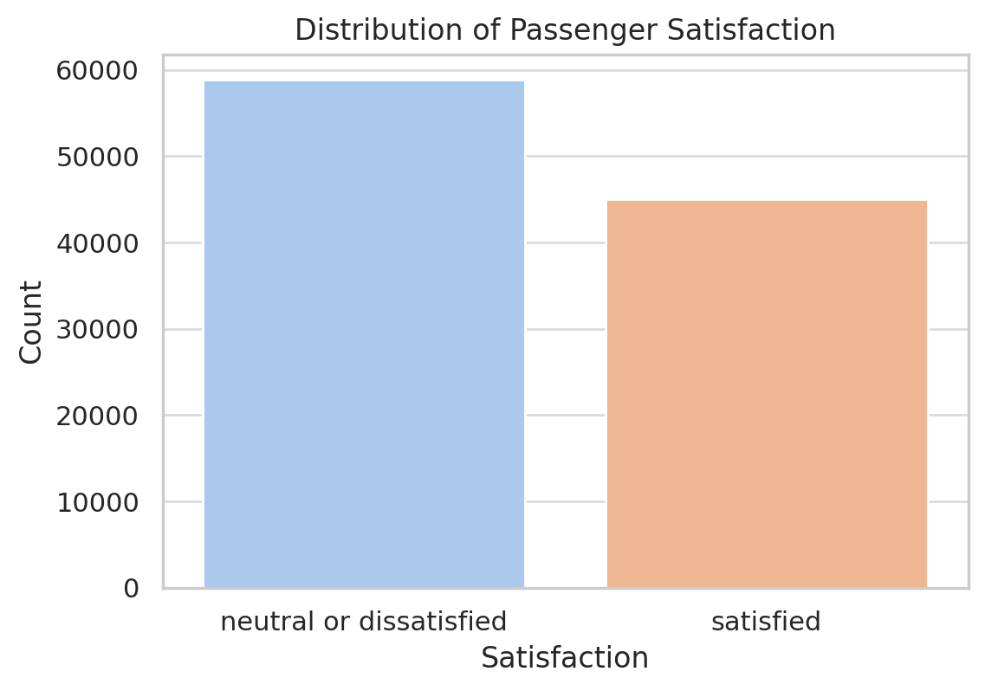
EDA
DISTRIBUTION OF PASSENGER SATISFACTION
Understanding the distribution of the target variable is the first step in predictive modeling.
The satisfaction variable is binary, with two categories: "Satisfied" and "Neutral or Dissatisfied".
A bar plot revealed that a larger portion of passengers fall into the "Neutral or Dissatisfied" category.
This imbalance is important, as it can lead to biased models that favor the majority class.
This insight prompted the need for stratified sampling or accuracy-balanced evaluation metrics like precision, recall, and F1-score.

Slide 12

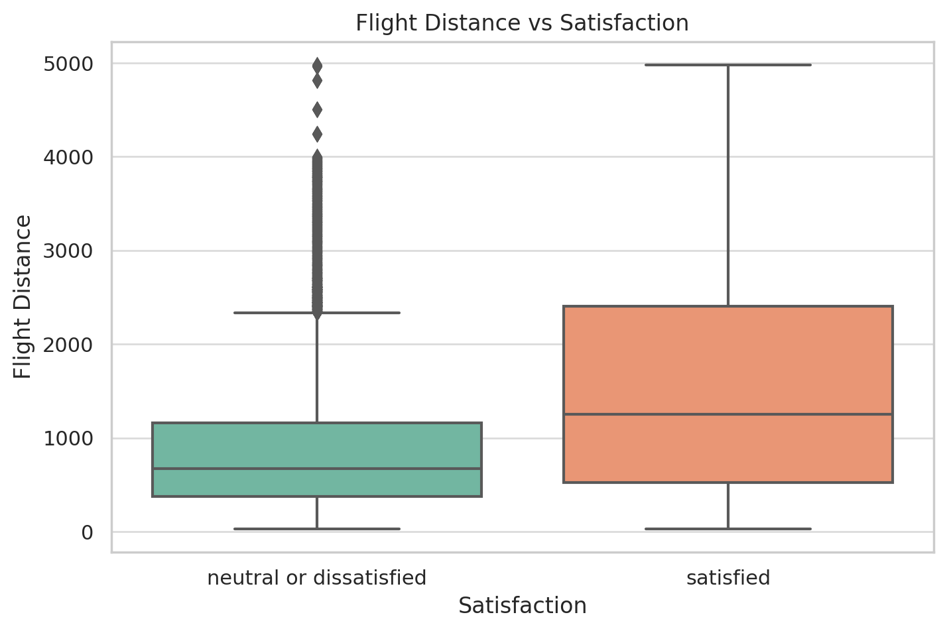
EDA
FLIGHT DISTANCE VS SATISFACTION
Are long flights more satisfying, or are they just better staffed?
A boxplot comparing satisfaction levels against flight distance uncovered a trend:
Satisfied passengers tend to travel longer distances.
These long-distance flyers are more likely to be business travelers, flying premium classes, and receiving better services.
This suggests that service quality and travel comfort are prioritized on longer flights, directly contributing to increased satisfaction.

Slide 13

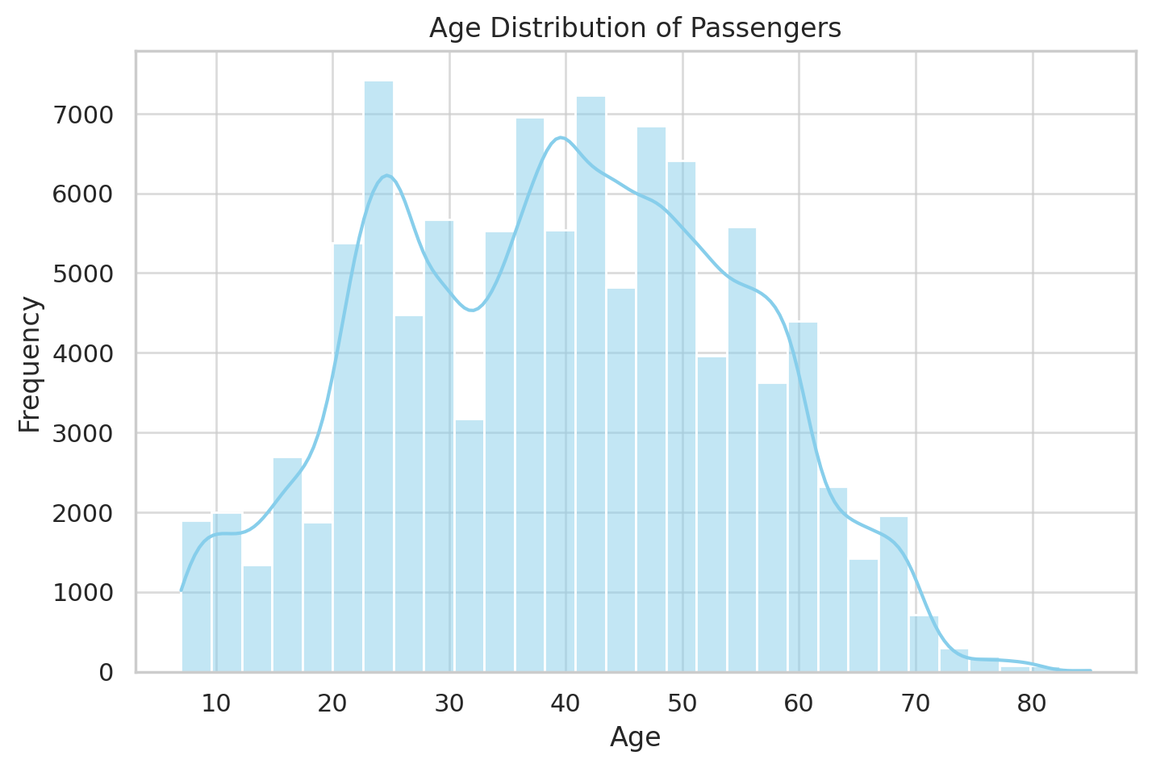
EDA
AGE DISTRIBUTION OF PASSENGERS
Who are the airline's typical passengers?
A histogram of age shows a bell-shaped distribution, indicating a normal age spread.
Most passengers fall between ages 25 and 60, representing a working-age demographic.
This helps airlines tailor services—such as digital access or boarding convenience—for their core audience.
Understanding this demographic distribution also allows segmentation by age group in later analysis stages.

Slide 14

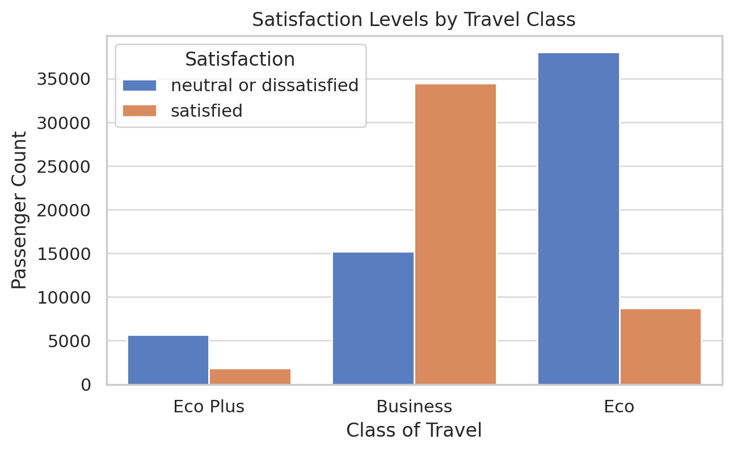
EDA
SATISFACTION BY TRAVEL CLASS
Do premium travelers get a better experience?
A grouped bar chart comparing class of travel to satisfaction was used.
Results were striking:
Business class passengers are significantly more satisfied than others.
Economy class showed the highest dissatisfaction rate.
This reinforces that travel class is one of the most impactful variables when analyzing passenger sentiment.
Airlines could consider boosting perks in economy to balance customer experiences.

Slide 15

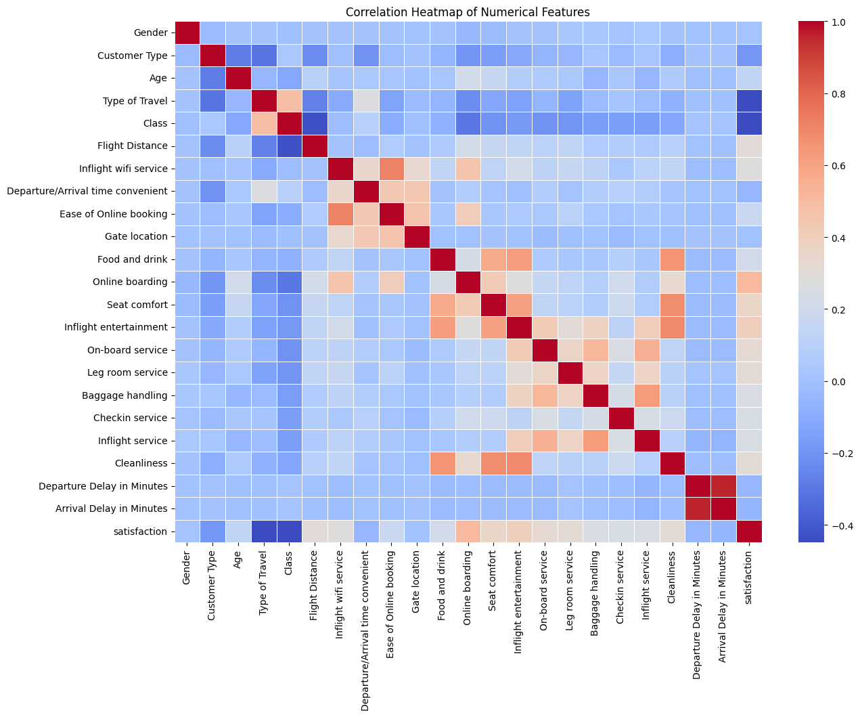
EDA
CORRELATION HEATMAP
Which service factors truly influence satisfaction?
A correlation heatmap was created to identify linear relationships between features.
Strong positive correlations exist among service-related variables like Seat comfort, Inflight entertainment, On-board service, and Cleanliness
Notably, negative correlations were observed between Departure Delay and overall satisfaction.
The Satisfaction variable correlates moderately with: Online boarding, Seat comfort, On-board service
This guided us toward choosing these as strong candidate features for modeling.

Slide 16
STATISTICAL & CORRELATION ANALYSIS
I wanted to figure out which features are actually linked to whether a passenger is satisfied or not. So I started with a correlation analysis to see which numerical features—especially those related to service ratings—have a strong relationship with satisfaction. This helped me narrow down the most important variables that are worth focusing on when building the model.
I also ran chi-square tests for the categorical columns, like gender, to check if certain groups of passengers tend to be more or less satisfied. These tests were useful because they gave me a clearer idea of which categories might influence the outcome, and helped me make better decisions when creating my classification models later on.

Slide 17
STATISTICAL & CORRELATION ANALYSIS
Top 5 Positively Correlated Features with Satisfaction
Feature | Correlation
Online boarding | 0.504
Inflight entertainment | 0.398
Seat comfort | 0.349
On-board service | 0.322
Leg room service | 0.313
The better these services are rated, the more likely a passenger is to be satisfied.

Slide 18
STATISTICAL & CORRELATION ANALYSIS
Top 5 Negatively Correlated Features with Satisfaction
Feature | Correlation
Departure/Arrival time convenient | -0.052
Arrival Delay in Minutes | -0.057
Customer Type (disloyal) | -0.188
Type of Travel (personal) | -0.449
Class (economy) | -0.449
Passengers flying for personal reasons, flying economy, or experiencing delays are more likely to be dissatisfied.

Slide 19
STATISTICAL & CORRELATION ANALYSIS
Chi-Square Test: Gender vs Satisfaction
Metric | Value
Chi-Square Statistic | 15.44
p-value | 0.00008496
Gender and satisfaction are statistically dependent — i.e., gender does play a role (though possibly small) in predicting satisfaction.

Slide 20
LOGISTIC REGRESSION
I wanted to build a simple and interpretable model that could predict whether a passenger is likely to be satisfied based on their travel and service experience. I decided to use Logistic Regression because it’s straightforward to implement, easy to explain, and works really well for binary classification problems like this one. It also helped me understand which features had the biggest influence on satisfaction, which was useful not just for prediction, but also for gaining insights.

Slide 21

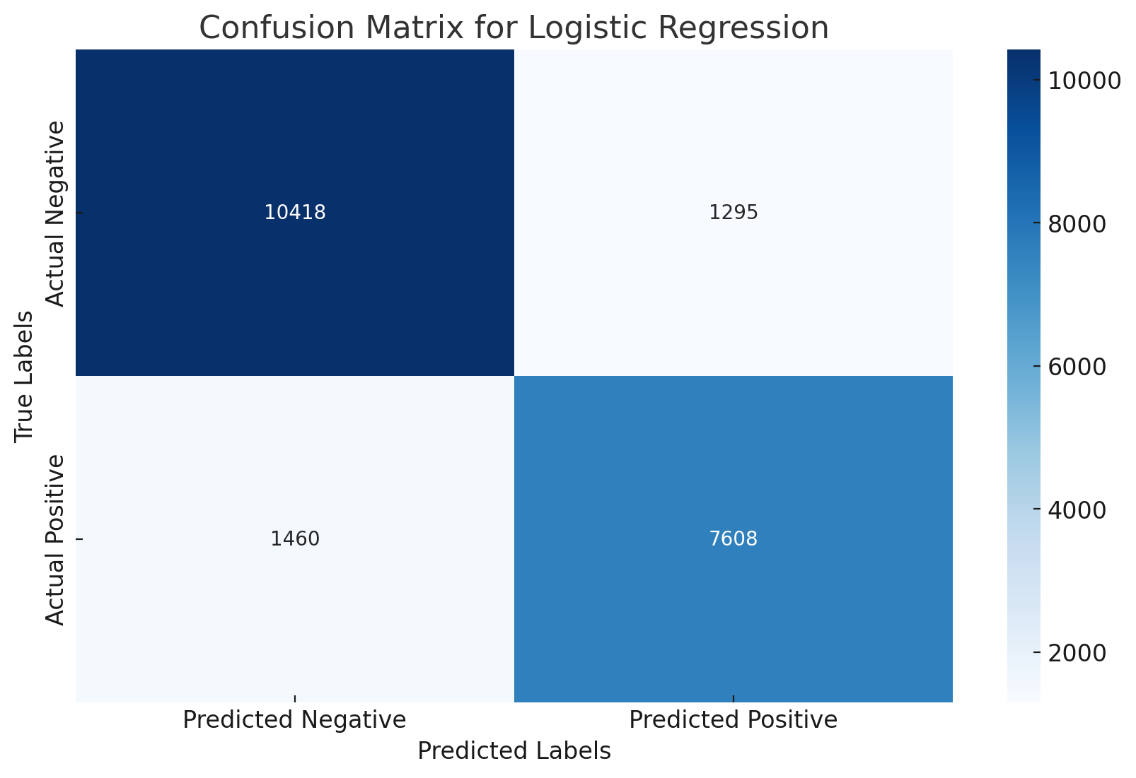
LOGISTIC REGRESSION
Upon evaluation, the model achieved an accuracy of 86.7%, demonstrating strong predictive performance across both satisfied and dissatisfied classes. The performance was further assessed using precision, recall, and F1-score metrics, particularly for the “Satisfied” class:
Precision: 85.5%
Recall: 83.9%
F1-Score: 84.6%
The model showed slightly higher recall for dissatisfied passengers, suggesting better sensitivity in identifying negative experiences. Overall, Logistic Regression proved effective not only in accuracy but also in providing insight into which features are most influential in determining customer satisfaction. Its interpretability makes it valuable for both predictive and explanatory analysis in airline customer experience modeling.

Slide 22
RANDOM FOREST
I wanted to use a more powerful model that could capture complex patterns in the data. So I went with Random Forest. Since it’s an ensemble method, it combines multiple decision trees and can handle nonlinear relationships and interactions between features really well. I used it to classify passenger satisfaction based on all the preprocessed data—including service ratings, demographics, and travel details. Compared to logistic regression, it has the potential to give higher accuracy, especially when the data isn’t linearly separable.

Slide 23

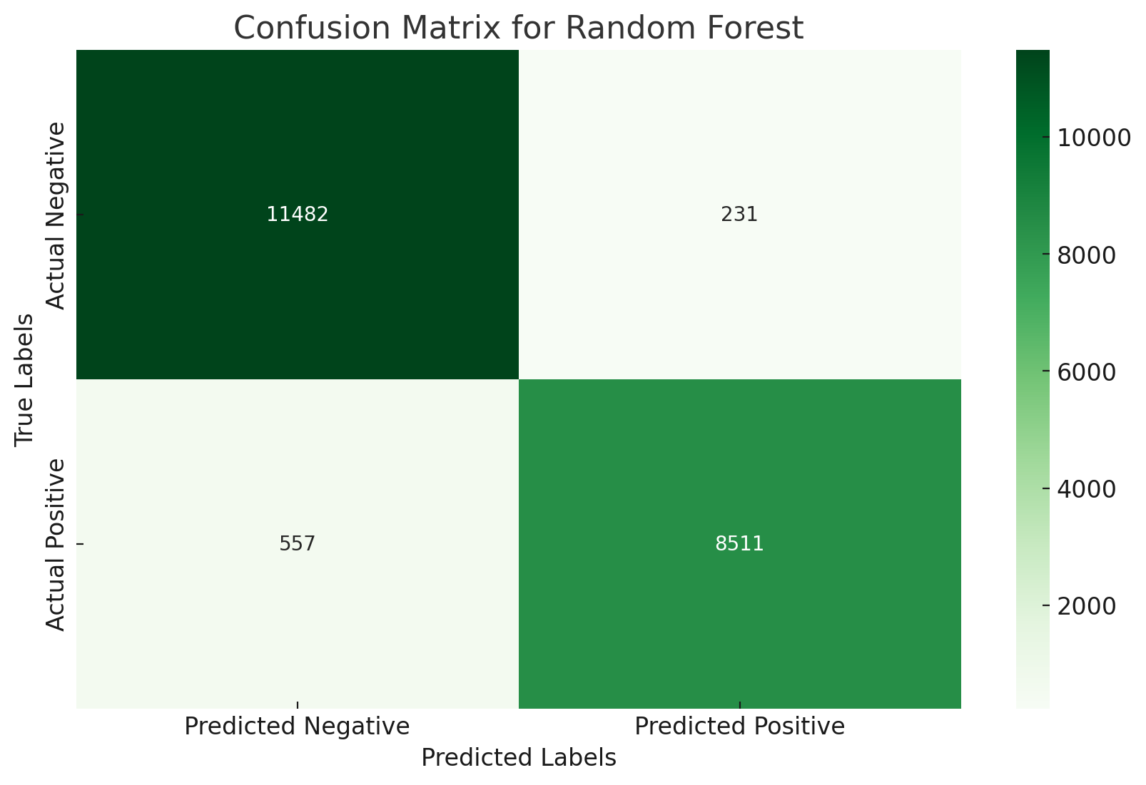
RANDOM FOREST
Performance Overview
Accuracy: 96.2%
Precision (Satisfied): 97.4%
Recall (Satisfied): 93.9%
F1-Score (Satisfied): 95.6%
The model also demonstrated excellent performance in identifying dissatisfied passengers, achieving an F1-score of 96.7% for that class.

Slide 24
Discussions and CONCLUSION
To wrap up the project, I wanted to focus on how all the analysis I’ve done can be applied in the real world. The final step here is about turning my data findings into practical, actionable recommendations that an airline can use to improve how passengers experience their service.

Slide 25
CONCLUSION
The analysis reveals that airline passenger satisfaction is influenced by a combination of service quality, operational efficiency, and travel-related factors. Passengers who rated features like online boarding, inflight entertainment, seat comfort, and on-board service highly were significantly more satisfied, highlighting these as areas for continued investment. Delays in departure and arrival negatively impacted satisfaction, emphasizing the need for reliable scheduling. Travel class and purpose also played a role—business travelers and those in premium cabins reported higher satisfaction, while economy and personal travelers were less satisfied, pointing to a service gap that airlines could address. Additionally, loyal customers consistently expressed greater satisfaction, reinforcing the value of well-designed loyalty programs in driving long-term retention.
Based on these findings, several strategic directions are recommended. Enhancing the economy-class experience—through better seating, personalized service, or improved inflight amenities—can directly address the dissatisfaction seen in that segment. Streamlining digital services, such as boarding and online booking, is also crucial given their direct correlation with satisfaction. Operationally, minimizing delays through better scheduling and contingency planning could significantly improve customer perception. Strengthening loyalty programs to provide value-added perks will help build deeper customer relationships. Lastly, integrating predictive models, such as the Random Forest classifier used in this project, into customer feedback systems could help airlines proactively identify dissatisfied passengers and act before negative experiences escalate.

Slide 26
CONCLUSION
That said, there were some limitations in the analysis. For example, while the dataset was rich in structured ratings, it lacked free-text feedback or sentiment-based data, which could provide deeper context to the satisfaction scores. Additionally, some features showed mild imbalance, and future versions of the model could benefit from balancing techniques or stratified sampling.
Going forward, expanding the dataset with more granular service details (e.g., flight route, crew rating, or aircraft type) and incorporating temporal analysis (e.g., seasonal satisfaction trends) would allow for an even deeper understanding. There is also potential to deploy real-time predictive models that help airlines identify at-risk passengers and proactively enhance service delivery.
In conclusion, this project demonstrates how data science methods can be effectively applied to real-world customer experience problems, offering both predictive power and operational insight.

Slide 27
REFERENCES
Rokach, L., & Maimon, O. (2005). Decision trees. In Data mining and knowledge discovery handbook (pp. 165–192). Springer.
https://link.springer.com/chapter/10.1007/0-387-25465-X_9
Namukasa, J. (2013). The influence of airline service quality on passenger satisfaction and loyalty: The case of Uganda airline industry. The TQM Journal, 25(5), 520–532.
https://www.emerald.com/insight/content/doi/10.1108/tqm-11-2012-0092/full/html
Sharma, S., & Kumar, R. (2022). An overview of data analysis and interpretations in research. ResearchGate.
https://www.researchgate.net/publication/365668845_An_Overview_of_Data_Analysis_and_Interpretations_in_Research
Katuwal, G. J., & Bohara, A. K. (2021). Machine learning in predicting health outcomes: A primer. Frontiers in Public Health, 9, 693103.
https://pmc.ncbi.nlm.nih.gov/articles/PMC8274472/

Slide 28
Proof of Work (via GitHub)
All code, analysis, and visualizations for this project are available in my GitHub repository:
https://github.com/samanth-777/Airplane-satisfaction-data-science-project.git

Slide 29
THANK YOU
PROJECT BY SAMANTH MADHESH

